Slide 1
Travelers to Louisiana
by Air and Sea
Sadiat Ibrahim, Jennifer Jung, Solomon Loche

Slide 2
Application Area
At any given time information may be needed about specific people or the number of people that entered the state.
Louisiana Police Department
This database can help the Police Department identify anyone if they need to track travelers that caused any crime.
Louisiana Health Department
The Health Department can use this database to keep track of new visitors that are from areas where COVID and other diseases are highly impacted. This could advise travelers to quarantine themselves.
Louisiana Office of Tourism
If the Office of Tourism wants to research how many travelers tour in Louisiana, this database can help compare how many tourists Louisiana has to the other states.
Commercial Airlines
This database can be used by commercial airlines to review how often people use their services and which destinations most people are traveling to.

Slide 3
Need for Application
We are creating a database of all the people that enter and leave the state, this system will need to do the following:
Keep track of travel information
Catalog what transportation travelers use when entering the state
Keep track of each plane used and how many people were on that plane
Record what airport each plane lands at
Record what harbor boats arrive at
Keep track of traveler’s information
Keep track of general information regarding each person who enters the state
Store a record of when people enter and leave (if they do)
Record who people are traveling with (if anyone)
Allows users of the database to view broad reasons for each person’s trip:
Business
Personal
Tourism

Slide 4
Requirements
Travelers can be traveling with other travelers
Multiple travelers can land at a single airport
Multiple travelers can dock at a single harbor
The date that a traveler arrives must be recorded, but a scheduled exit date is not required
Travelers must specify their trip as business, personal, or tourism
A child must use the identification of parent/dependent if they do not have their own
If a traveler is using a personal plane, the plane must be stored at the airport they land at
Boats must be docked at the harbor the traveler arrives at

Slide 5
Forbidden Requirements
Airports and docks cannot store more planes or boats than their max capacity
Travelers stopping for connecting flights are not to be considered/stored
If a personal plane is used it cannot belong to an airline, and vice versa
The number of a plane’s passengers cannot exceed the max capacity
A traveler using a personal plane cannot land at an airport filled to its max capacity

Slide 6
Schema - Entities and Relationships
Entities
Traveler( tID, DOB, Name, ID_Type, Address(State/Country, Street Address), Travel_Reason, Scheduled_Exit_Date)
Plane(pID, Type, isPersonal, Max_Capacity, #_of_Passengers)
Harbor(hID, Name, Location, Max_Capacity, Occupancy)
Boat(bID, Name, Type)
Airport(Airport_ID, Occupancy, Max_Capacity, Type, Location, Name)
Airline(Airline_ID, Name)
Relationships
Traveling_With(tID, tID)
Flies(tID, pID)
Lands_At(tID, Airport_ID)
Sails(tID,bID)
Owns(pID, Airline_ID)
Stores(pID, Airport_ID)
Docks_At(tID, hID)
Docked(hID, bID)

Slide 7
Integrity Constraints
Entity integrity - all entity has a primary key and all primary keys are not null and are unique.
Referential integrity - makes sure relationships has a foreign key that references a primary key

Slide 8
BCNF
1NF: Multivalued attribute/Composite attributes
Violated 1NF, had a composite attribute
2NF: partial dependencies
Did not have any partial dependencies
3NF: transitive dependencies
Did not have any transitive dependencies
BCNF:
Is in BCNF
Solution:
Get rid of composite attribute Address

Slide 9
Functional Dependencies
Old Functional Dependencies
{tID → DOB, Name, ID_Type, Address (State/Country, Street Address), Travel_Reason, Scheduled_Exit_Date}
{pID → Type, isPersonal, Max_Capacity, #_of_Passengers}
{hID → Name, Location, Max_Capacity, Occupancy}
{bID → Name, Type}
{Airport_ID → Occupancy, Max_Capacity, Type, Location, Name}
{Airline_ID → Name}
{(tID, hID) → Date}
{(tID, Airport_ID) → Date}
New Functional Dependencies
{tID → DOB, Name, ID_Type, Travel_Reason, Scheduled_Exit_Date, Street Address, State/Country}
{pID → Type, isPersonal, Max_Capacity, #_of_Passengers}
{hID → Name, Location, Max_Capacity, Occupancy}
{bID → Name, Type}
{Airport_ID → Occupancy, Max_Capacity, Type, Location, Name}
{Airline_ID → Name}
{(tID, hID) → Date}
{(tID, Airport_ID) → Date}

Slide 10
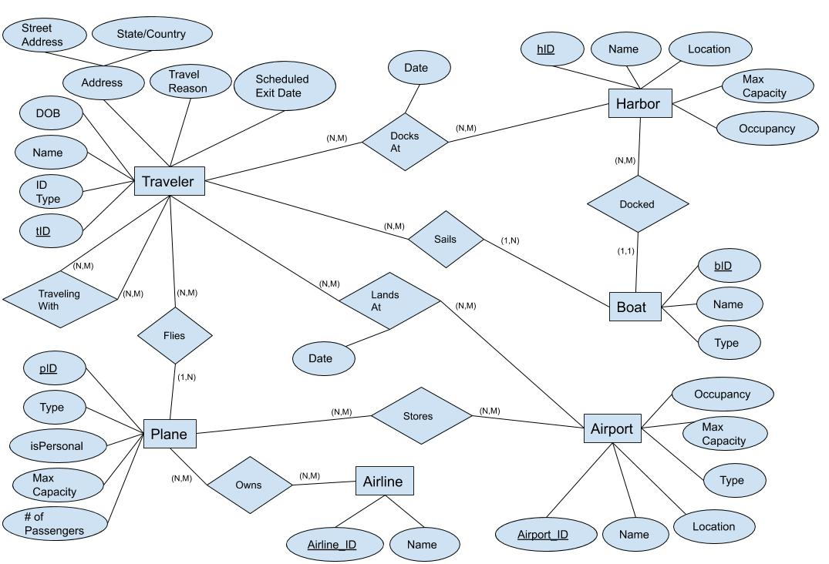
Old E/R Model

Slide 11
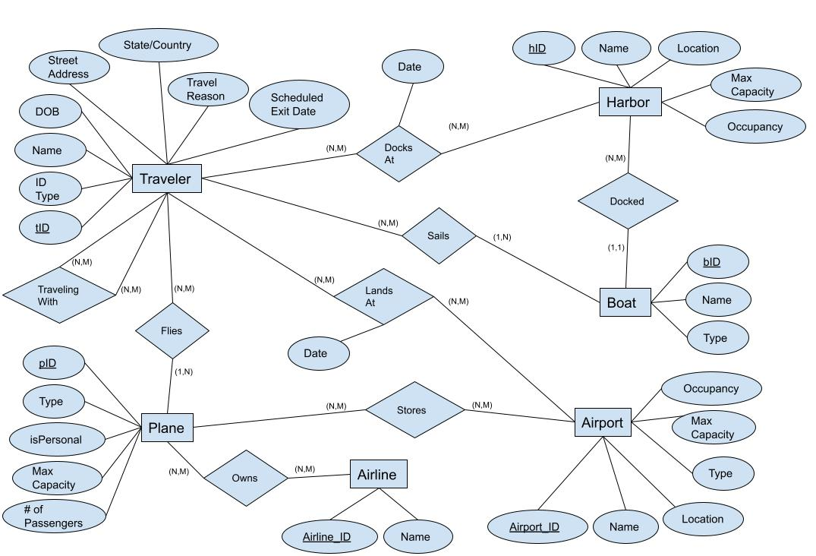
New E/R Model

Slide 12
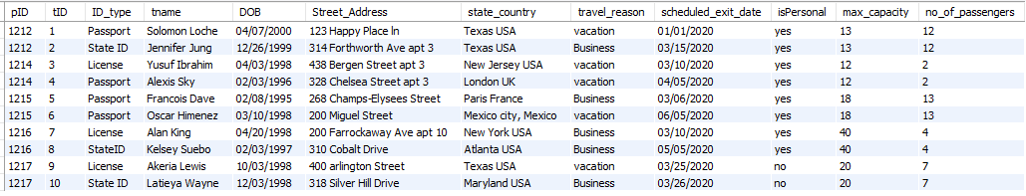
View
View that returns all the planes that the travelers are flying on.

Slide 13
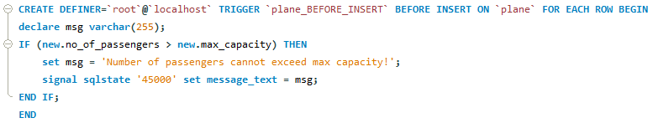
Trigger
This trigger makes sure that the no_of_passenger doesn’t exceed the max_capacity of each plane.

Slide 14

Team Roles
Sadiat Ibrahim
BCNF
Integrity Constraints
Jennifer Jung
DDL Commands
Created Powerpoint
Solomon Loche
Made views and triggers
DML Commands
We worked on the ER diagram and functional dependencies as a group.

